Slide 1
REQUIREMENT ENGINEERING

Slide 2
Previously…
Introduction to Requirement Analysis
Structuring Requirements (Use Cases and User Stories)
Requirement Prioritization
Conflict Resolution in Requirements
Requirement Modeling
Quality Attributes of Good Requirements
PIECES Framework for Requirement Analysis
Tools for Requirement Analysis

Slide 3
Lesson 6: Requirement Specification

Slide 4
Chapter Outlines
Introduction to Requirement Specification
Structure of a Software Requirements Specification (SRS) Document
Writing Clear Requirements
Validation and Verification of Requirements
Deliverables at the End of the Requirement Specification Phase

Slide 5
1. Introduction to Requirement Specification
Requirement Specification is the process of clearly defining and documenting all the system's functional and non-functional requirements.
It typically results in an SRS document, which outlines what the system will do and how it will perform under different conditions.
Objectives:
Ensure all stakeholders (developers, testers, clients) have a clear understanding of system requirements.

Slide 6
1. Introduction to Requirement Specification
Provide a baseline for system design, development, and testing.
Serve as a reference throughout the software development lifecycle to avoid scope creep and misunderstandings.

Slide 7
2. Structure of a Software Requirements Specification (SRS)
A well-organized SRS should be clear, concise, and complete. It typically follows a standard structure, which includes the following sections:
2.1 Introduction
Purpose: State the goal of the SRS document and its intended audience (developers, project managers, testers, etc.).
Scope: Provide a description of the system, including what the system will and will not cover.

Slide 8
2. Structure of a Software Requirements Specification (SRS)
Definitions, Acronyms, and Abbreviations: List any technical terms or acronyms used in the document.
References: Mention any related documents, standards, or guidelines.
Overview: Provide an overview of the rest of the SRS, briefly summarizing its content.

Slide 9
2. Structure of a Software Requirements Specification (SRS)
2.2 System Overview
System Purpose: Explain the overall objectives of the system and how it fits into the business or user needs.
System Context: Describe how the system will interact with other systems or stakeholders.
Assumptions and Dependencies: List any assumptions made during the requirements gathering process and any dependencies on external systems or components.

Slide 10
2. Structure of a Software Requirements Specification (SRS)
2.3 Functional Requirements
Definition: Functional requirements define the specific behaviors or functions of the system. These are typically described as actions the system must perform.
Approach: Break down the system's functional requirements into use cases, user stories, or features. Each requirement should be numbered and described in detail.

Slide 11
2. Structure of a Software Requirements Specification (SRS)
Example format for functional requirements:
FR1: User Registration
The system must allow new users to register by providing their email, password, and contact details.
FR2: Product Search
The system must allow users to search for products by entering keywords, categories, or price ranges.

Slide 12
2. Structure of a Software Requirements Specification (SRS)
FR3: Real-time Sensor Data (Smart Irrigation)
The system must collect real-time sensor data (moisture, temperature) and adjust irrigation schedules automatically.
For each functional requirement:
Inputs: Specify the input data or trigger events.
Processing: Describe what the system does with the input.
Outputs: Detail the expected result or system behavior.

Slide 13
2. Structure of a Software Requirements Specification (SRS)
FR3: Real-time Sensor Data (Smart Irrigation)
The system must collect real-time sensor data (moisture, temperature) and adjust irrigation schedules automatically.
Application
Inputs: moisture and temperature readings pushed every 60 seconds from field sensors
Processing: compare readings against configured thresholds for the crop type
Outputs: updated irrigation schedule and an alert if the sensor is not working

Slide 14
2. Structure of a Software Requirements Specification (SRS)
In Class Activity
Think of a domain for which you are creating an app.
Choose three feature of the app / web app / system and write it as a function requirement in the format shown before.
Write the input, process and output.
Swap with another group. Can they understand your functional requirement without asking a question?

Slide 15
2. Structure of a Software Requirements Specification (SRS)
2.4 Non-Functional Requirements (NFRs)
Non-functional requirements define system attributes, such as performance, security, usability, and scalability.
Example format for non-functional requirements:
NFR1: Performance
The system must respond to user actions within 2 seconds for 90% of requests.

Slide 16
2. Structure of a Software Requirements Specification (SRS)
NFR2: Security
All sensitive data must be encrypted in transit and at rest using industry-standard encryption algorithms.
NFR3: Usability
The system must be accessible to users with disabilities, conforming to WCAG 2.0 standards.

Slide 17
2. Structure of a Software Requirements Specification (SRS)
Types of Non-Functional Requirements:
Performance: Response times, throughput, load handling.
Security: Encryption, access control, audit trails.
Usability: Ease of use, accessibility, user interface design.
Reliability: failure rates
Availability: System uptime
Scalability: Ability to handle increased loads or expand functionality.

Slide 18
2. Structure of a Software Requirements Specification (SRS)
Compliance: Adherence to industry standards or regulations (e.g., GDPR, HIPAA).

Slide 19
2. Structure of a Software Requirements Specification (SRS)
In Class Activity: KAHOOT!! kahoot.it

Slide 20
Yesterday…
Introduced to Requirement Specification
Some sections that make up an SRS Document
Documenting FRs and NFRs

Slide 21
2. Structure of a Software Requirements Specification (SRS)
2.5 System Models
In this section, various models and diagrams should be included to visually represent the system’s behavior and structure. These models help clarify and communicate requirements more effectively.
Use Case Diagrams: Illustrate how different users (actors) interact with the system.
Data Flow Diagrams (DFDs): Show how data moves through the system and the processes that transform it.

Slide 22
2. Structure of a Software Requirements Specification (SRS)
Entity-Relationship Diagrams (ERDs): Represent the relationships between data entities within the system.
Sequence Diagrams: Depict how system components interact over time to complete a process.

Slide 23
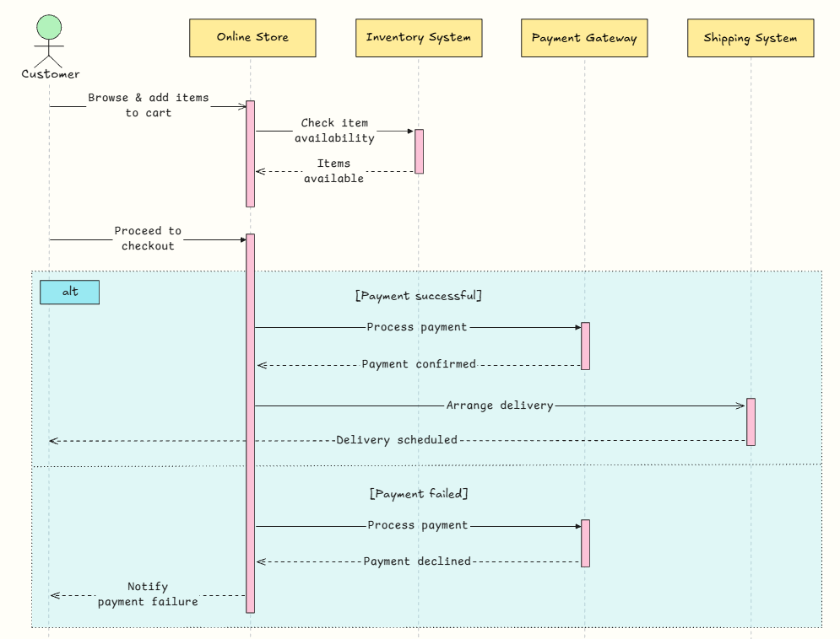
Sequence Diagram

Slide 24
2. Structure of a Software Requirements Specification (SRS)
2.6 User Requirements
User Personas: Describe the different types of users who will interact with the system.

Slide 25
2. Structure of a Software Requirements Specification (SRS)
2.7 External Interface Requirements
User Interfaces (UI): Define how the system will look and feel. Include Figma prototypes or wireframes for visualization.
Hardware Interfaces: List any hardware that the system will interact with (e.g., IoT sensors, medical devices).
Software Interfaces: Specify the interactions with external software systems (e.g., APIs, databases).

Slide 26
2. Structure of a Software Requirements Specification (SRS)
Communication Interfaces: Detail the protocols and data formats used for communication between system components (e.g., RESTful APIs, HTTP, WebSockets).

Slide 27
2. Structure of a Software Requirements Specification (SRS)
2.8 Constraints and Limitations
Hardware Limitations: Describe any constraints related to hardware (e.g., sensor battery life, bandwidth).
Time Constraints: Outline project timelines and deadlines that affect the system’s design or development.
Legal and Regulatory Constraints: Specify any legal requirements the system must meet (e.g., data privacy laws, industry regulations).

Slide 28
2. Structure of a Software Requirements Specification (SRS)
2.9 Assumptions and Dependencies
Assumptions: List any assumptions made during the requirements gathering process (e.g., "It is assumed that users will have access to high-speed internet").
Dependencies: Identify any external dependencies or components that the system relies on (e.g., third-party APIs, external databases).

Slide 29
3. Writing Clear Requirements
Guidelines for writing clear, unambiguous requirements:
Use simple, concise language: Avoid jargon or complex terms that may confuse stakeholders.
Be specific: Requirements should not be vague or open to interpretation.
Make requirements testable: Ensure each requirement can be verified through testing or inspection.

Slide 30
3. Writing Clear Requirements
Prioritize requirements: Clearly indicate which requirements are critical and which are optional (e.g., using MoSCoW prioritization).
Example:
Poorly Written Requirement: The system should load quickly.
Well-Written Requirement: The system must load the dashboard page within 2 seconds when accessed from a broadband connection (minimum 10 Mbps).

Slide 31
4. Validation and Verification of Requirements
Once the SRS is completed, it is essential to validate and verify the requirements to ensure they meet the stakeholder's expectations and are feasible for implementation.
Validation: Ensures that the documented requirements reflect the real needs of the stakeholders.
Techniques: Requirements review meetings, user acceptance testing (UAT), and stakeholder interviews.

Slide 32
4. Validation and Verification of Requirements
Verification: Confirms that the requirements are clear, complete, and testable.
Techniques: Inspection, walkthroughs, and peer reviews.

Slide 33
5. Deliverables at the End of the Requirement Specification Phase
Complete SRS Document: A finalized document outlining all system requirements, models, and constraints.
Figma Prototypes: Visual representation of the system's user interface.
Reviewed and Signed Off Requirements: Ensuring stakeholder agreement on the documented requirements.

